Slide 1
Programming Fundamentals
By
Shazmeen Batool

Slide 2
Lab Task 1
Write a menu driven C++ program that ask the user to choose the type in which he wants the output?
Either he wants to convert the entered Celsius temperature in to Fahrenheit or Kelvin?

Slide 3
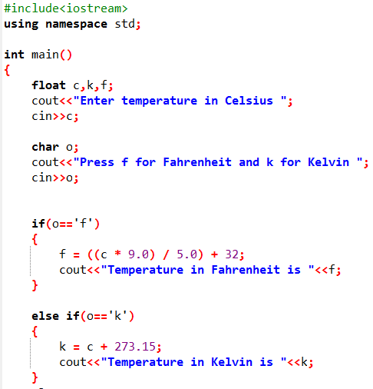



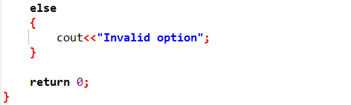

Output 1:
Output 2:
Output 3:
Issue:

Slide 4
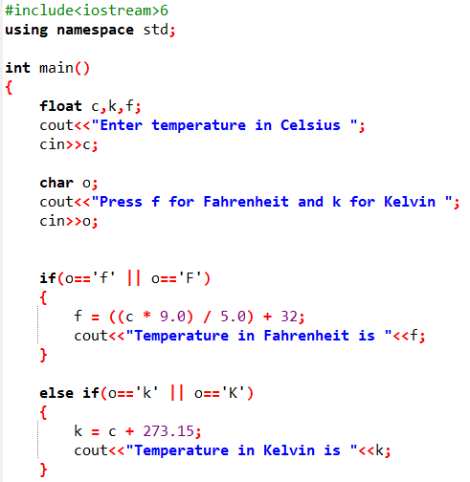
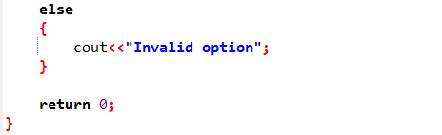

Output:

Slide 5
Lab Task 2
Write a C++ program to check whether a character is alphabet or not.

Slide 6
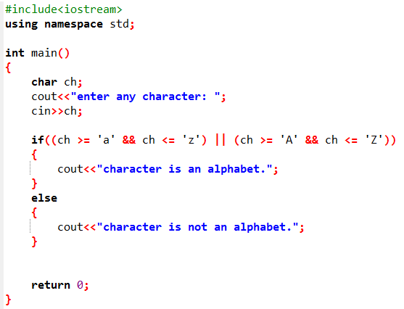


Output 1:
Output 2:

Slide 7
Lab Task 3
Write a C++ program to input angles of a triangle and check whether triangle is valid or not.

Slide 8
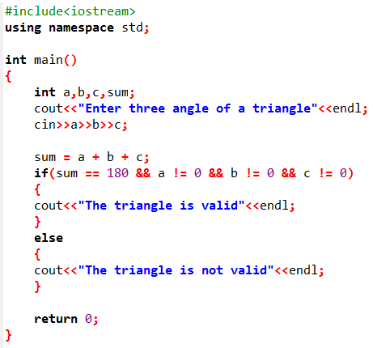
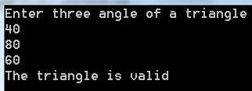
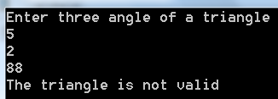
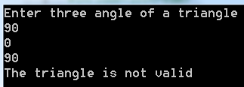
Output 1:
Output 2:
Output 3:

Slide 9
Lab Task 4
Write a C++ program to input angles of a triangle and check whether triangle is valid or not using Nested if.

Slide 10
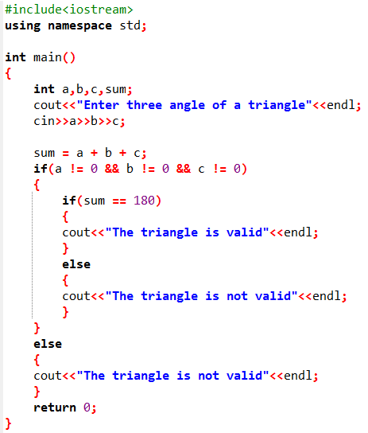

Slide 11
Lab Task 5
Write a C++ program to check whether a character is vowel or consonant.

Slide 12
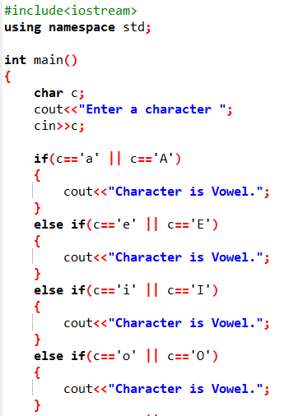


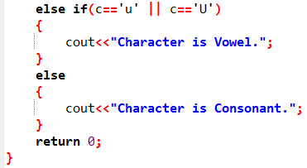
Output 1:
Output 2:

Slide 13
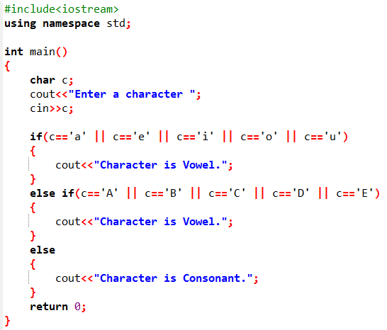
Method 2

Slide 14
Lab Task 6
Write a menu driven C++ program for simple calculator using if else-if.

Slide 15
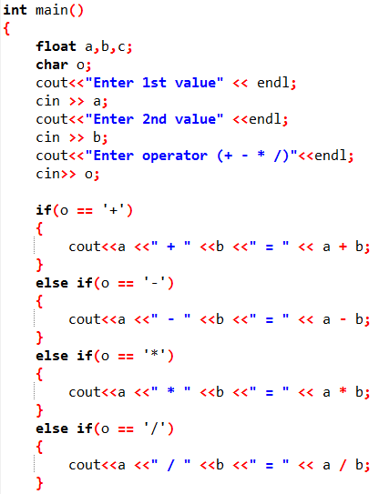
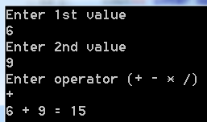
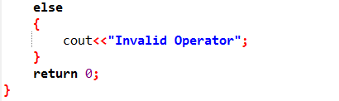
Output:

Slide 16
Lab Task 7
Write a program to input three numbers and find largest between all.

Slide 17
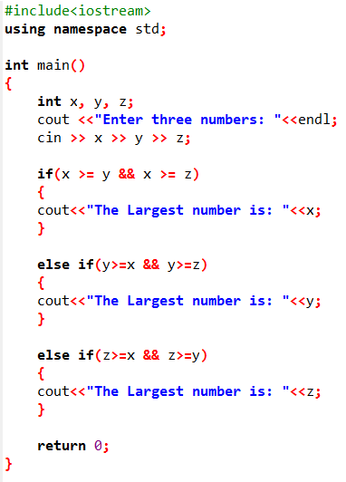
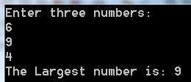
Output:

Slide 18
Lab Task 8
According to your grading system mark the user entered percentage as Grade A, B, C, D, F?
Percentage >=90 A grade
Percentage >=80 B grade
Percentage >=70 C grade
Percentage >=60 D grade
Percentage >=40 E grade
Percentage <40 F grade

Slide 19
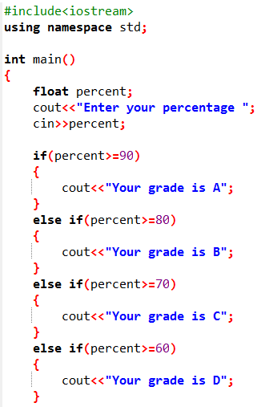


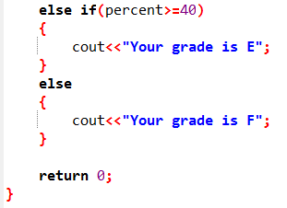
Output 1:
Output 2:

Slide 20
Task: Chinese Zodiac Year using Switch
Now let us write a program to determine the Chinese Zodiac sign for a given year. The Chinese Zodiac is based on a twelve-year cycle, each year being represented by an animal: rat, ox, tiger, rabbit, dragon, snake, horse, sheep, monkey, rooster, dog, and pig, in this cycle, as shown in Figure 3.6 (next slide).
Note that year % 12 determines the Zodiac sign. 1900 is the year of the rat since 1900 % 12 is 4. Write a program that prompts the user to enter a year and displays the animal for the year.

Slide 21
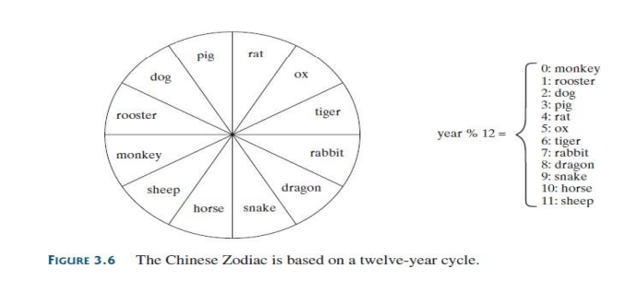
Task: Chinese Zodiac Year using Switch

Slide 22
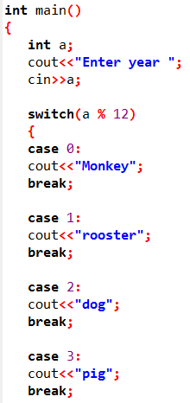
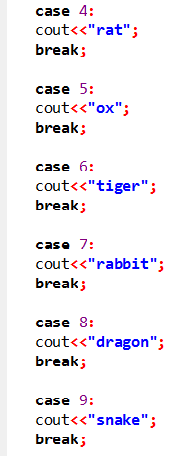
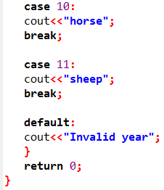

Output

Slide 23
Lab Task 10
Ask user to enter two numbers assign greater number to max
max = num1 > num2 ? num1 : num2;

Slide 24
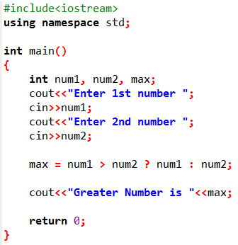

Output

Slide 25
Lab Task 11
Ask user to enter a number find if it is even or odd using ternary operators.

Slide 26
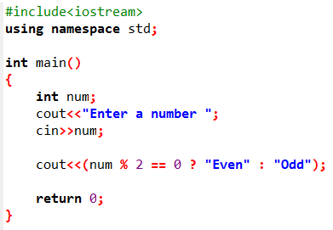


Slide 27
Lab Task 12
Write a C++ program that uses the weekday number to show the weekday name.

Slide 28
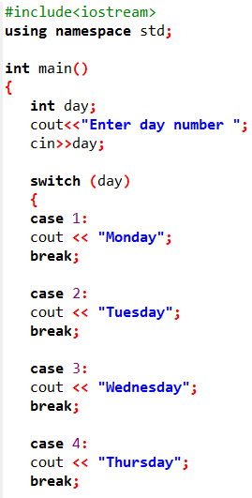
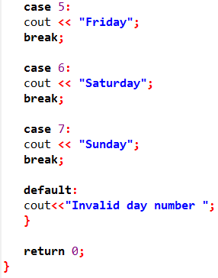

Output

Slide 29
Lab Task 13
Write C++ program for simple calculator using switch.

Slide 30
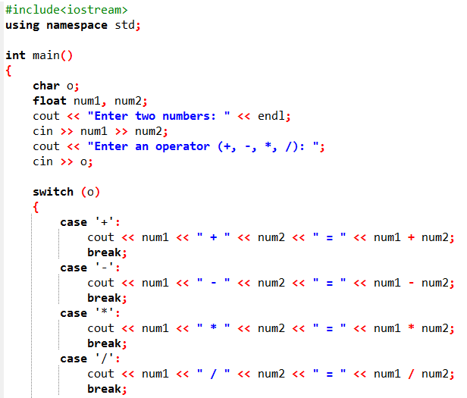
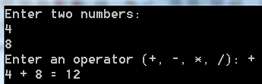
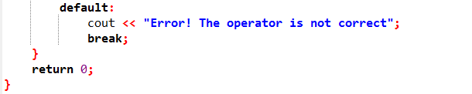

Slide 31
Lab Task 14
Write a C++ program to check whether a character is vowel or consonant using switch.

Slide 32
